Slide 1
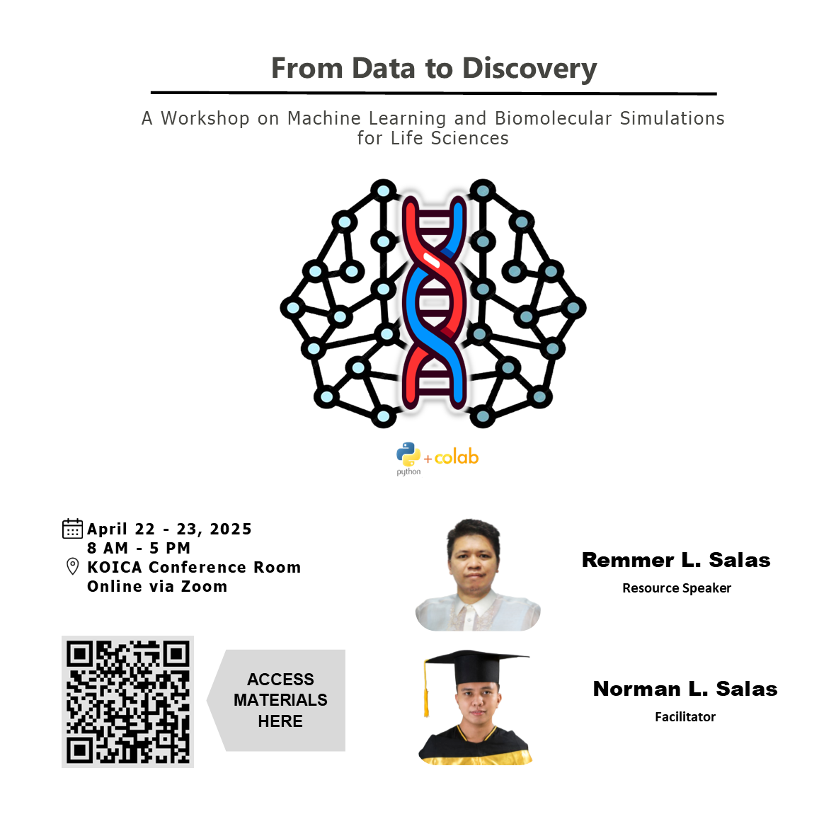

Slide 2
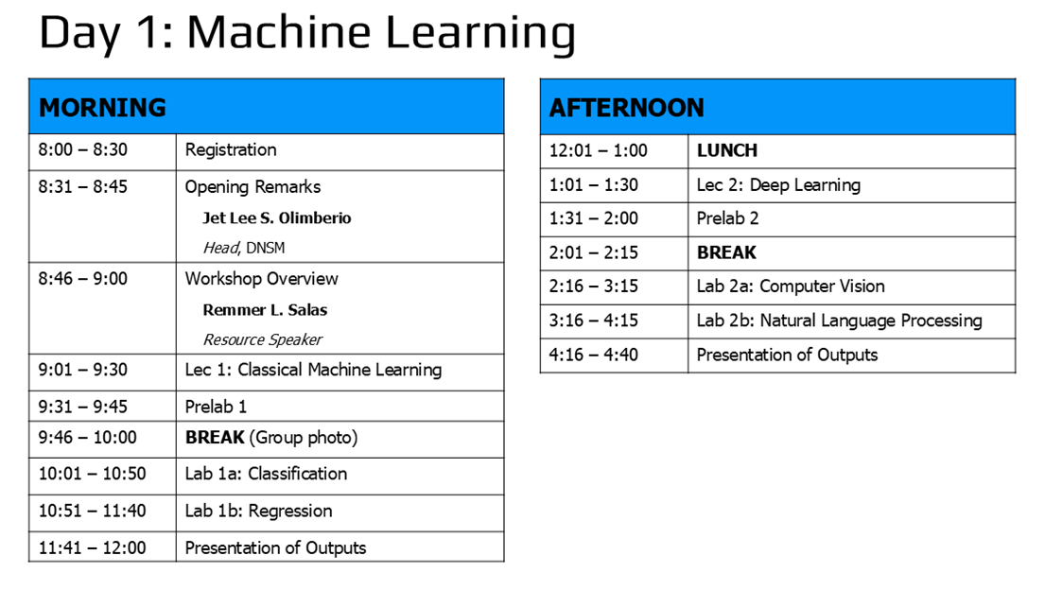

Slide 3
Deep Learning
LECTURE 2
Remmer L. Salas
Chemistry Instructor
Department of Natural Sciences and Mathematics
Visayas State University

Slide 4
Deep learning is for everyone
Myth | Truth
Lost of math | High school math is sufficient
Lots of data | Transfer & few-shot learning works with <50 samples
Lots of expensive computers | State-of-the-art work is possible with free compute from Google Colab & Kaggle

Slide 5
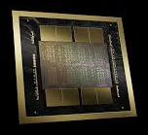
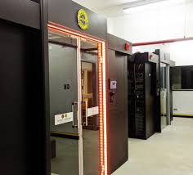
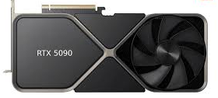
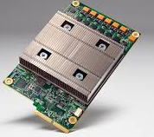
Why deep learning is possible now?
Better algorithms & understanding
More compute power (GPUs, TPUs)
Blackwell B200
21760 CUDA cores
32 GB VRAM
UP Data Commons
Tesla T4 GPU (16 GB VRAM)
TPUs
https://datacommons.up.edu.ph/about-updc/

Slide 6
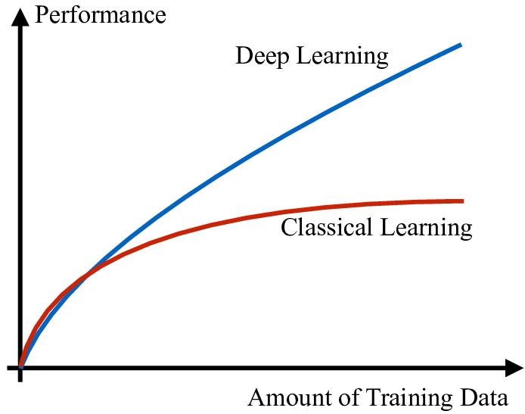







Why deep learning is possible now?
Data with labels
Open-source tools & models

Slide 7
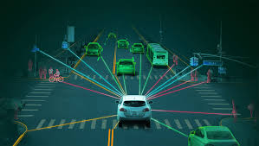
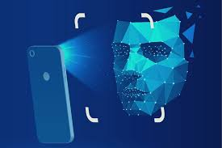
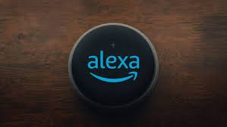

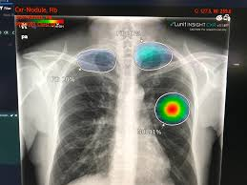
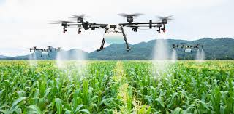

Applications of deep learning
Natural Language Processing (NLP)
Computer Vision
Autonomous vehicle
Facial recognition
Virtual assistant
Email spam filter
Medical imaging
Agriculture
Chatbot

Slide 8

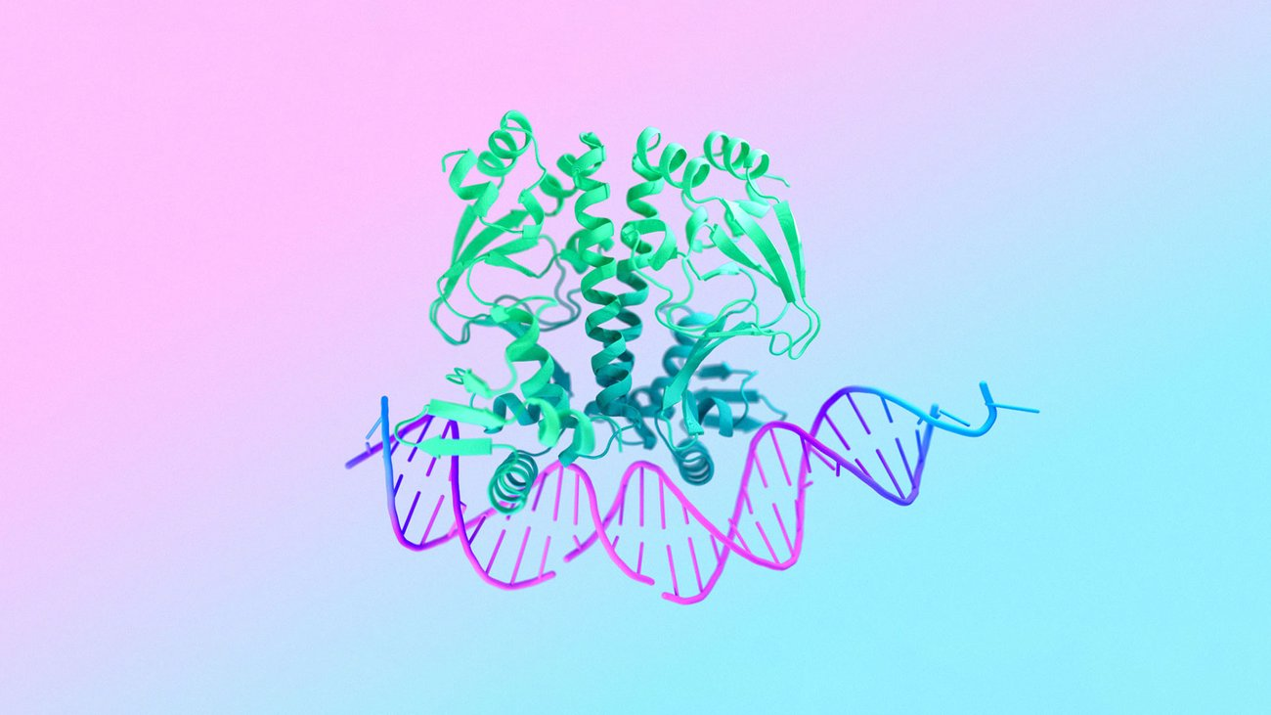
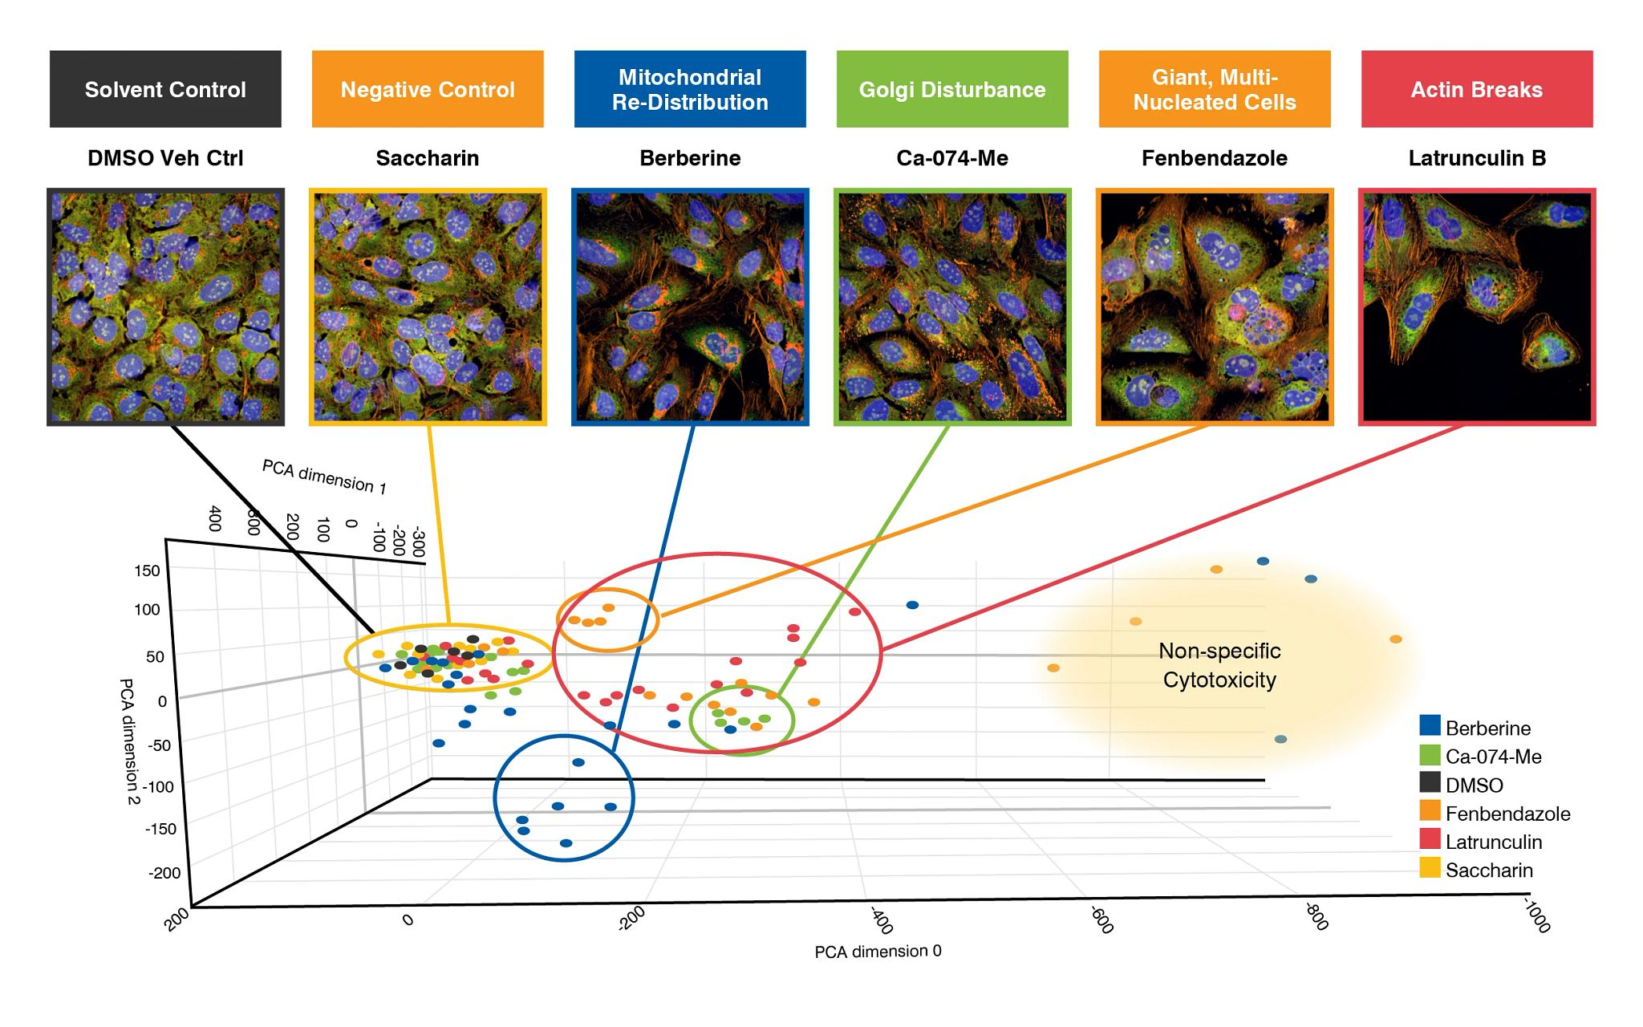

Image/Video generation
Biology
AlphaFold3
( Structure prediction)
Ghibli-style image
Cell painting (assay for understanding how cells respond to drugs or genetic changes)
Sora

Slide 9
How are these DL models trained?
(Table, Text, Image, Video, Audio)
(model)
(weights)
Howard & Gugger, 2020. Deep learning for coders with fastai & pytorch

Slide 10
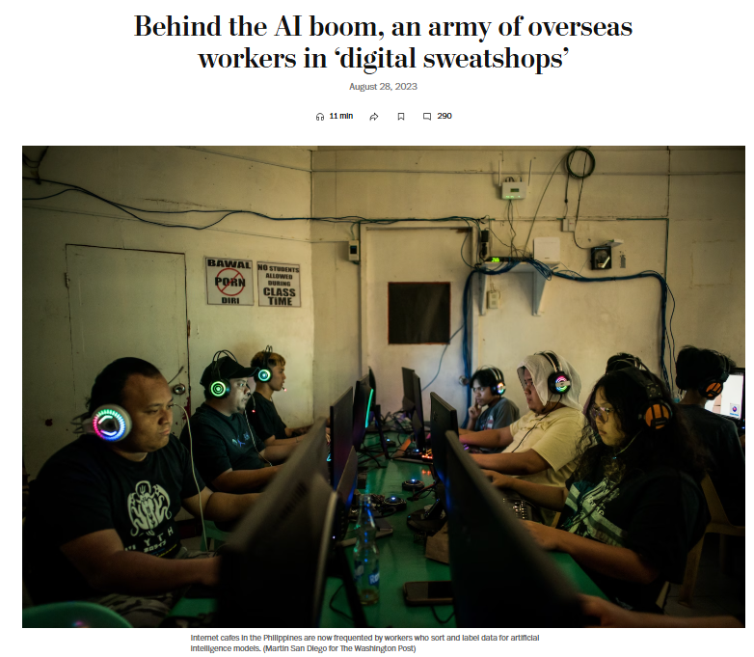
Limitations of ML model
cannot be created without data
learn to operate only the patterns seen in the input data used to train it
creates only predictions, not recommended actions
need labels
https://www.washingtonpost.com/world/2023/08/28/scale-ai-remotasks-philippines-artificial-intelligence/

Slide 11
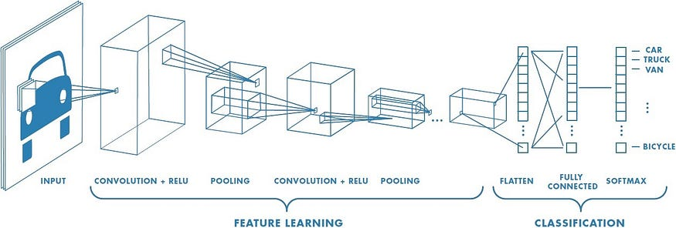
Convolutional neural network (CNN)
https://medium.com/data-science/a-comprehensive-guide-to-convolutional-neural-networks-the-eli5-way-3bd2b1164a53

Slide 12
Fast.ai vision library
# Import the fast.ai vision library
from fastai.vision.all import *
# Create a dataloader
dls = DataBlock(
blocks = (ImageBlock, CategoryBlock), # Inputs, Labels
get_items = get_image_files,
splitter = RandomSplitter(valid_pct = 0.2, seed = 42),
get_y = parent_label,
item_tfms = Resize(128))

Slide 13
Fast.ai vision library
# Create a CNN learner
learn = vision_learner(dls, ‘resnet26d’, metrics=[error_rate, accuracy]
# Find an appropriate learning_rate
learn.lr_find()
# Fine-tune the model
learn.fine_tune(3, 1e-1)

Slide 14
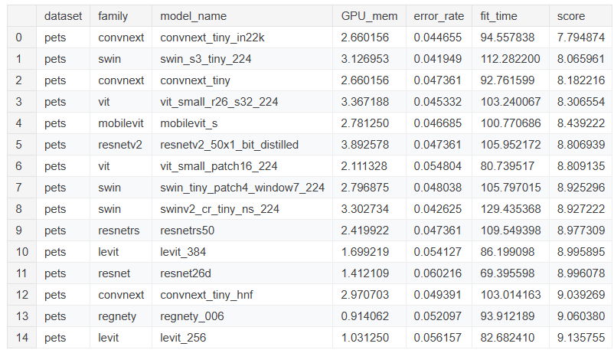
Pre-trained vision models
https://www.kaggle.com/code/jhoward/the-best-vision-models-for-fine-tuning

Slide 15
CNN model learned
Howard & Gugger, 2020. Deep learning for coders with fastai & pytorch

Slide 16

Learning rate
https://www.jeremyjordan.me/nn-learning-rate/

Slide 17
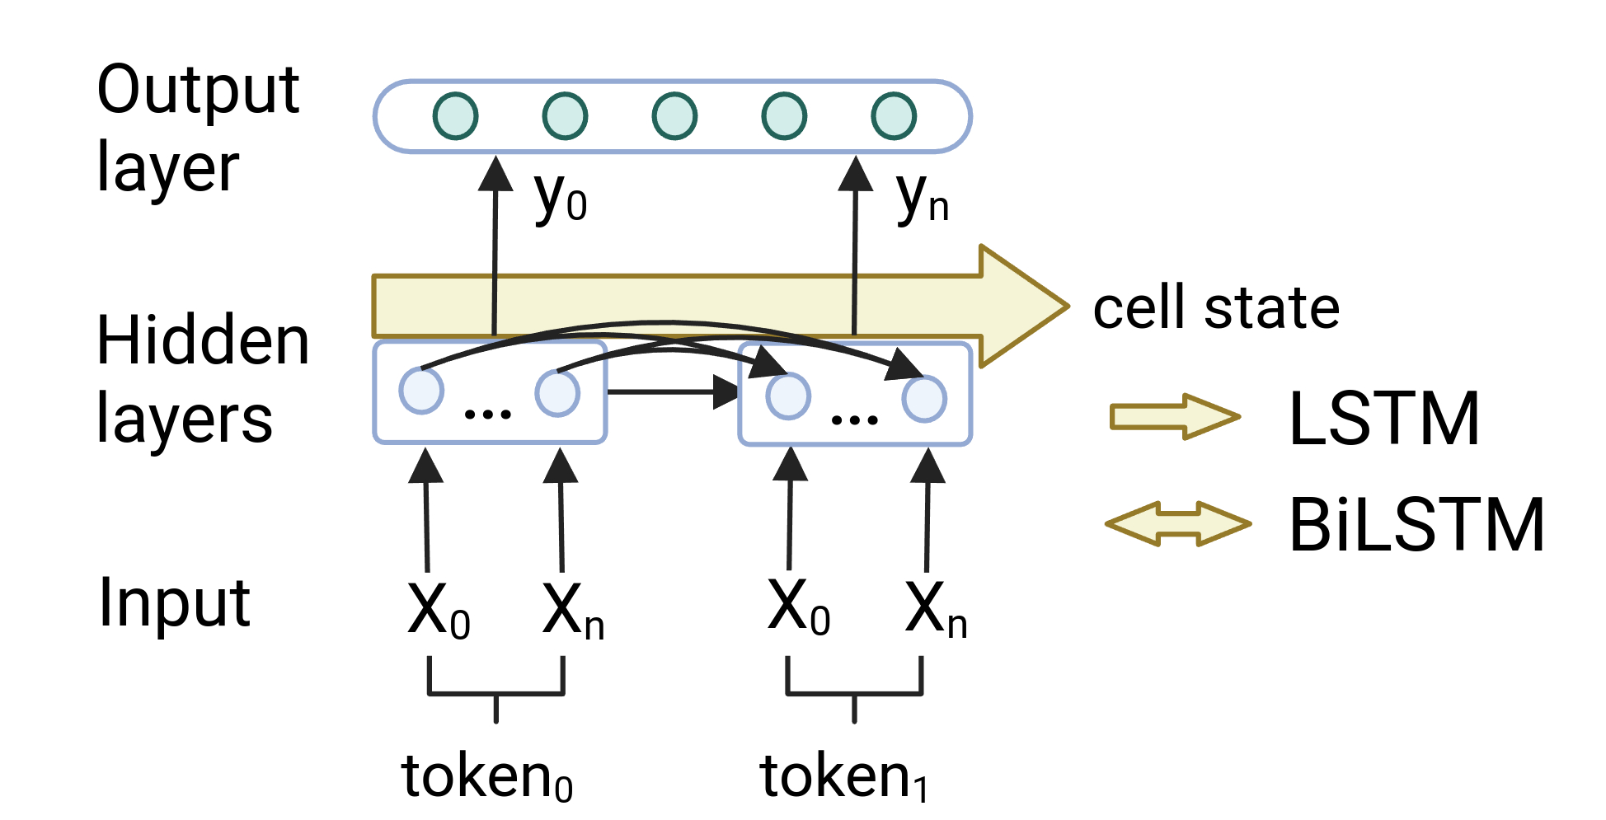
Recurrent neural network (RNN)
Problem of RNN: can’t remember context for long sentences

Slide 18
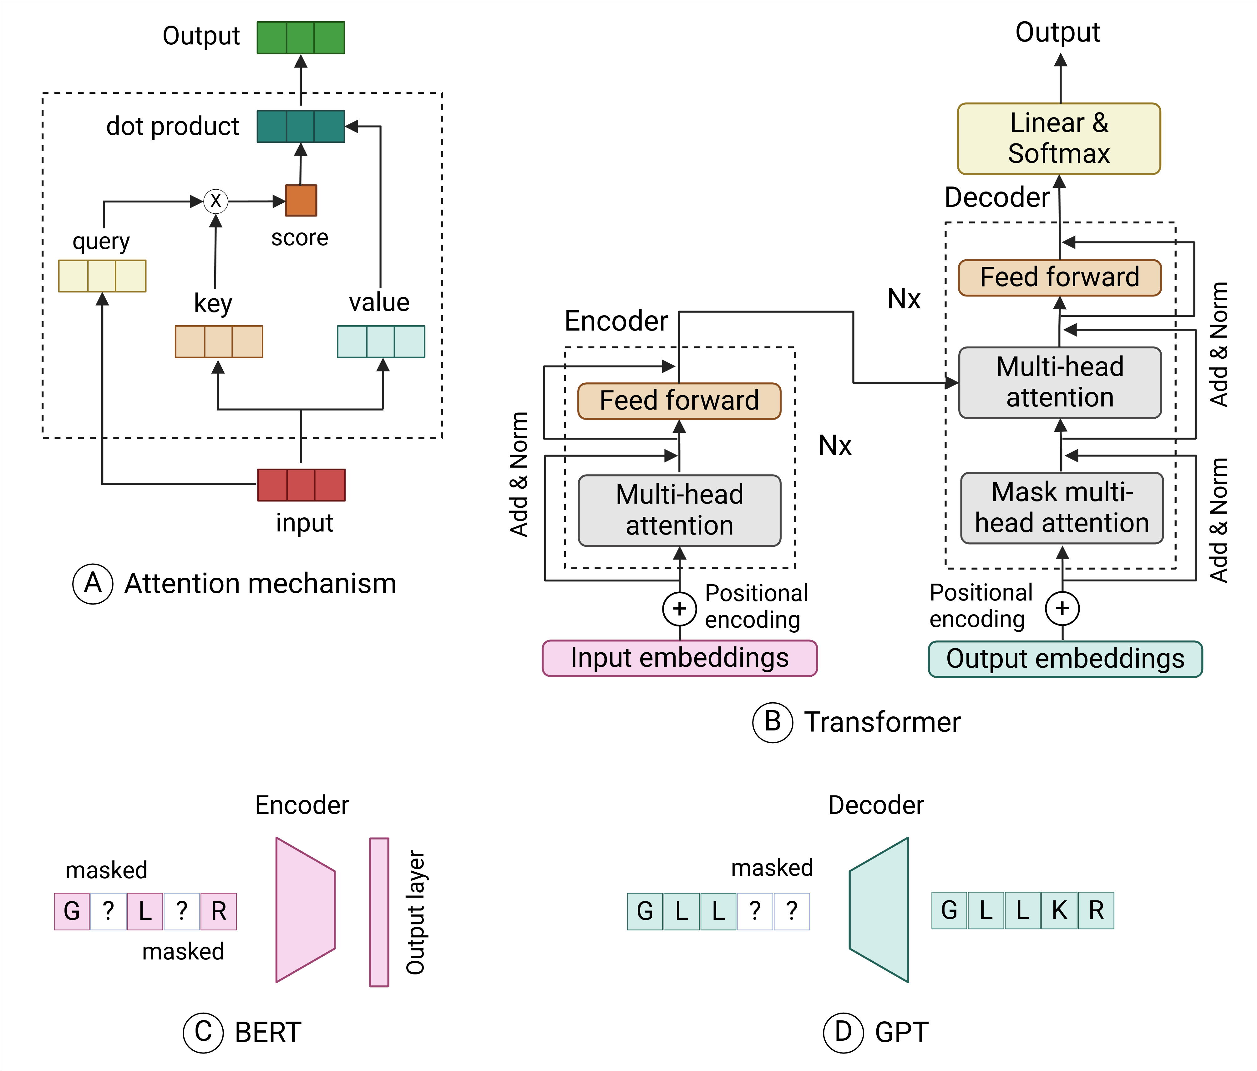
Attention-based models (optional)

Slide 19
Fast.ai text library
# Import the fast.ai text library
from fastai.text.all import *
# Create a dataloader
dls = DataBlock(
blocks = TextBlock(path, is_lm=True),
get_items = get_text_files,
splitter = RandomSplitter(valid_pct = 0.2, seed = 42),
bs = 64)

Slide 20
Fast.ai text library
# Create a LSTM learner
learn = text_classifier_learner(dls,
AWD_LSTM, drop_mult=0.5,
, metrics=[accuracy]
# Find an appropriate learning_rate
learn.lr_find()
# Fine-tune the model
learn.fine_tune(3, 1e-1)

Slide 21
Model deployment (optional)
Create an account in Hugging Face: https://huggingface.co
Watch the video here: https://www.youtube.com/watch?v=F4tvM4Vb3A0&list=PLfYUBJiXbdtSvpQjSnJJ_PmDQB_VyT5iU&index=2

Slide 22
For more tutorials & workshops…
Fast.ai course on DL: https://course.fast.ai/
ML for drug discovery summer school: https://www.youtube.com/watch?v=P5mz8bgp9-I&list=PLoVkjhDgBOt3NyXcTGg_fi-H8qBzNnKgk
Compbio Asia Workshop: https://compbioasia.net/
9th i-CoMSE workshop: Virtual School on ML for molecules: https://www.i-comse.org/workshops/

Slide 23
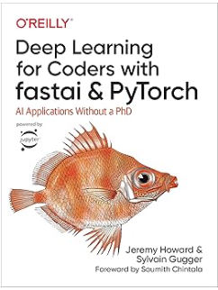
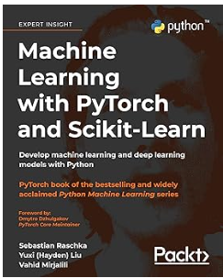
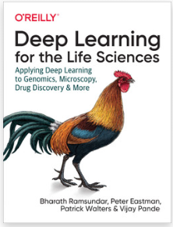
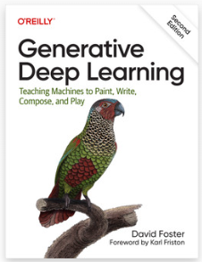
Recommended books
Can be downloaded in Anna’s archive (for educational purposes): https://annas-archive.org

Slide 24
Deep Learning
Prelab 2

